Slide 1
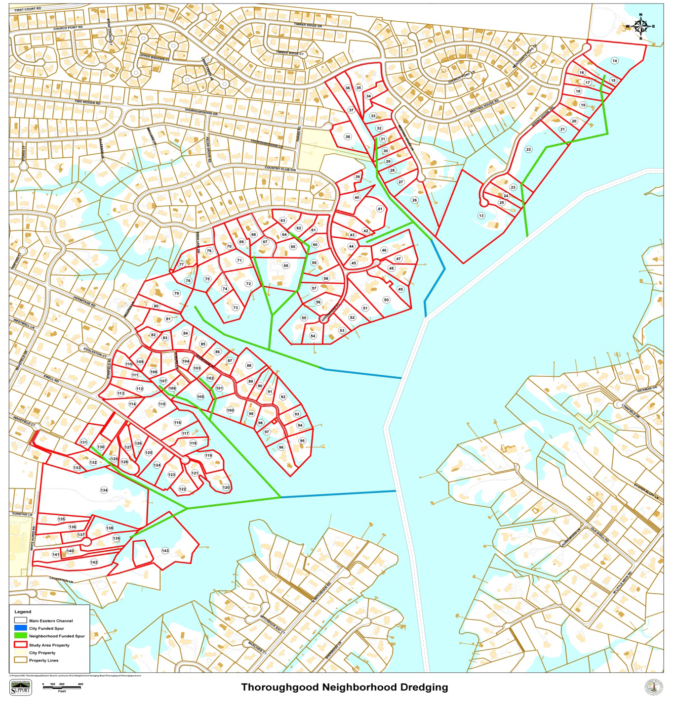
March 14, 2012
20¢/$100
$1,660/year
7 May 2014
51.5/$100
$3,863/year

Slide 2
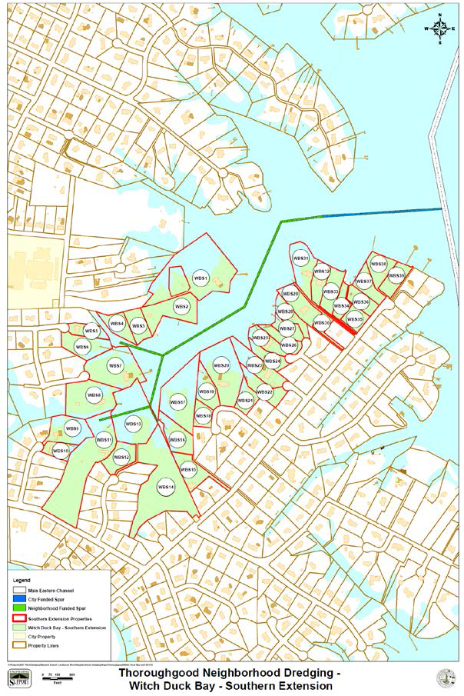
17 Sep 2012 Brief
24.5¢/$100
$2,061/year
7 May 2014 Brief
51.5/$100
$3,863/year

Slide 3
SSD effects on Witchduck / Thoroughgood Properties
2014* Property asmt. NOTE: 2015 assessments Increased 3.6%** | 2014 Tax | 93 cents Tax + SDD 51.5 =$144.5 (55% tax increase) | Increase | X 16 years Through 2031 (not counting change in city tax rate or further assessments) | Additional Cost for Driveways (thousands) Total for yrs 2, 9 & 16*** | Increase Asmt. from 2014 (15%) | Increase Assessment from 2014** (31%)
$516K | 4803 | 7444 | 2641 | 42,256 | 0 – 60K | 593K | 676K
$859K | 7994 | 12390 | 4396 | 70,336 | 0 - 60K | 988K | 1.117M
$1.013M | 9422 | 14604 | 5182 | 82,912 | 0 - 60K | 116K | 1.329M
$1.236M | 11497 | 17820 | 6323 | 101,168 | 0 – 60K | 1.421M | 1.619M
* City of Va Bch Properties: http://cvb.manatron.com/Tabs/PropertySearch.aspx
** The Virginian Pilot, Property Values rise in Virginia Beach, April 13, 2014
*** 13 Apr Preliminary Plan depicts numerous “Neighborhood channels” that did not appear in 2012 plans
City of Virginia Beach, Old Donation Policy Report, Sept 10, 2010, driveways range from $5K – 20K
**** Approximate assessments in 2008

Slide 4
SSD Comparison*
Community | Potential Residents | Total Est Cost | Cents/ $100 | Avg prop | SSD Annual Cost | Status
Witchduck/ Thoroughgood | 82 | $5.35M | 51.5 | 400K-1.2M+ | 1905 - 6965
Thoroughgood | 36 |  | 24.1 | 500K-1.7M |  | defeated
Churchpoint | 13 |  | 38 |  |  | defeated
Chesopeian | 142 | $3.225M | 31 | $545K | 1,429 | approved
Robin Hood Forest | 26 | $1.424M | 38.7 | $741 | 2,871 | defeated
Bayville | 12 | $1.35M | 36.3 | $1.2M | 4,361 | approved
Old Donation | 66 | $1.377M | 15.9 | $651K | 1,017 | approved
Dix Creek | 145 | $7.99M | 39.1 | 250K-1M | 978-3910
Little Neck | 38 | $1.796M | 30.4 | $850K | 2584
Harbor Point | 46 | $296K | 7.9 | $757K | 963
Hebdon Cove | 91 | $3.360M | 34.4 | 100 – 500K | 344-1720
* http://www.vbgov.com/government/departments/public-works/coastal/pages/neighborhood-channel-dredging.aspx

Slide 5
Old Donation Assessments
Plat # | 2010 Assessment* | 2014 Assessment** | Decrease
1478-73-8986-0000 | 605K | 526K | -79K
1478-93-4838-0000 | 1283K | 1166K | -117K
1478-93-6781-0000 | 1551K | 1544K | -7K
1478-93-6581-0000 | 1118K | 972K | -146K
1478-83-3837-0000 | 554K | 465K | -89K
1478-83-8159-0000 | 372K | 313K | -59K
* City of Va Bch, Neighborhood Dredging Special Service District Policy Report, Old Donation Creek Waterway Association
  (ODCWA), September 10, 2010
** http://www.vbgov.com/government/departments/public-works/coastal/pages/neighborhood-channel-dredging.aspx

Slide 6
WELCOME TO HERMITAGE POINT
South Side
North Side
Pay 55% more taxes
(144.5 cents/$100)
The Highest in Va Bch!
Pay an additional $2,000-5,800
annually for 16 years
to live here
Pay standard city tax
(93 cents/$100)
Save Money☺s

Slide 7
WELCOME TO Witchduck POINT
CAUTION
Entering highest taxed district in Virginia Beach
Pay 55% more taxes
(144.5 cents/$100)
The Highest in the city
Pay an additional $2,300 - $6,500
annually for 16 years to live here
CAUTION

